Slide 1
Classification
Tianhang Zheng
https://tianzheng4.github.io

Slide 2

Quantitative vs Qualitative Outputs
Regression mainly study quantitative outputs
$$Y=β_{0}+β_{1}X_{1}+β_{2}X_{2}+…+β_{p}X_{p}+ε$$
Classification mainly study qualitative outputs
Qualitative variables take values in an unordered set, i.e.,
$$eye color∈\left\{brown, black, green\right\}$$

Slide 3



Why not Linear Regression
Binary Classification: $Y=\{0, 1\}$
$$\hat{y}={\hat{β}}_{0}+{\hat{β}}_{1}x$$
As long as ${\hat{β}}_{1}$ is not zero, the prediction could be larger than 1 or smaller than 0
Logistic regression is more appropriate!

Slide 4


Logistic Regression
$$p(Y=1|X)=\frac{e^{β_{0}+β_{1}X}}{1+e^{β_{0}+β_{1}X}}$$
$p\left(Y=1 | X\right)$ always has values between 0 and 1
$$\log\left(\frac{p}{1−p}\right)=β_{0}+β_{1}X$$

Slide 5
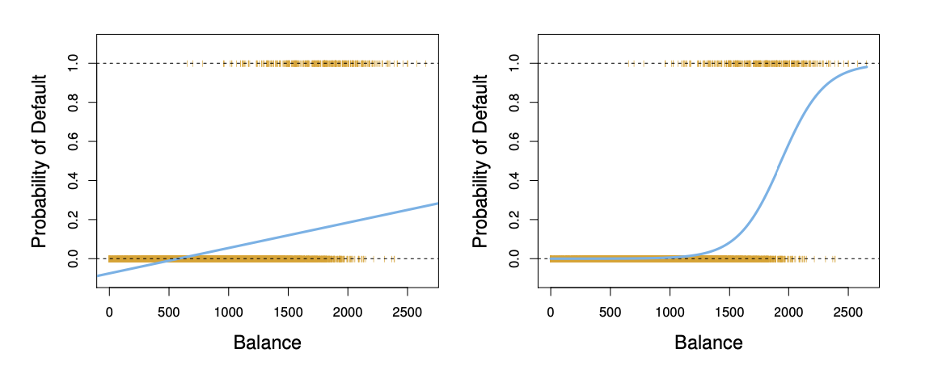
Linear Regression vs Logistic Regression

Slide 6

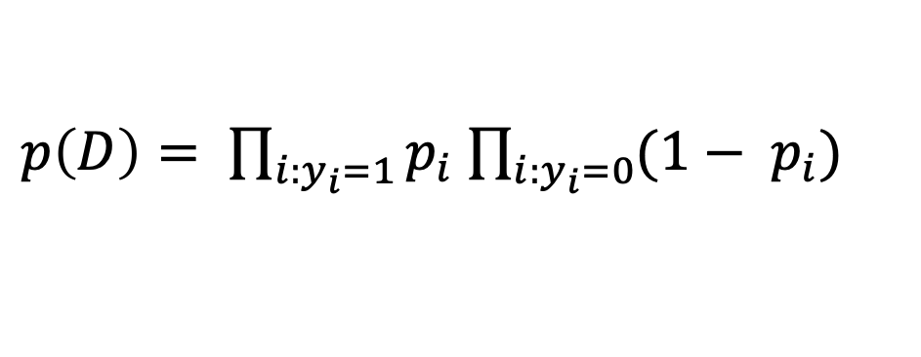
Maximum Likelihood Method
Commonly used for parameter estimation of logistic regression
Assume that the predictors are independent
$p\left(D\right)= \prod_{i:y_{i}=1}{p_{i}}$ $\prod_{i:y_{i}=0}{{(1− p}_{i})}$
$$p_{i}= p(y_{i}=1|x_{i})$$
This likelihood characterizes the probability of the observed data

Slide 7
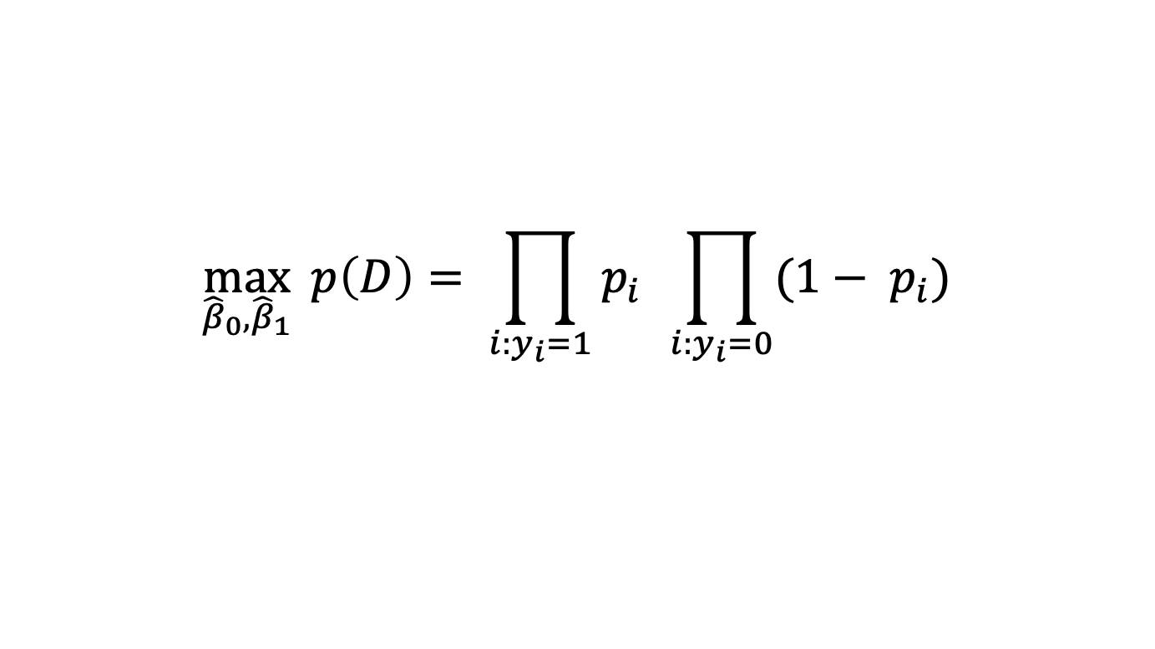
Maximum Likelihood Method
$$\max_{{\hat{β}}_{0},{\hat{β}}_{1}}{ p\left(D\right)= \prod_{i:y_{i}=1}{p_{i}} \prod_{i:y_{i}=0}{{(1− p}_{i})}}$$
Take the derivative and set it as 0
In practice, we could use sklearn

Slide 8
Q & A

